Slide 1

17 – 24 August 2019
www.worldtransplantgames.org

Slide 2

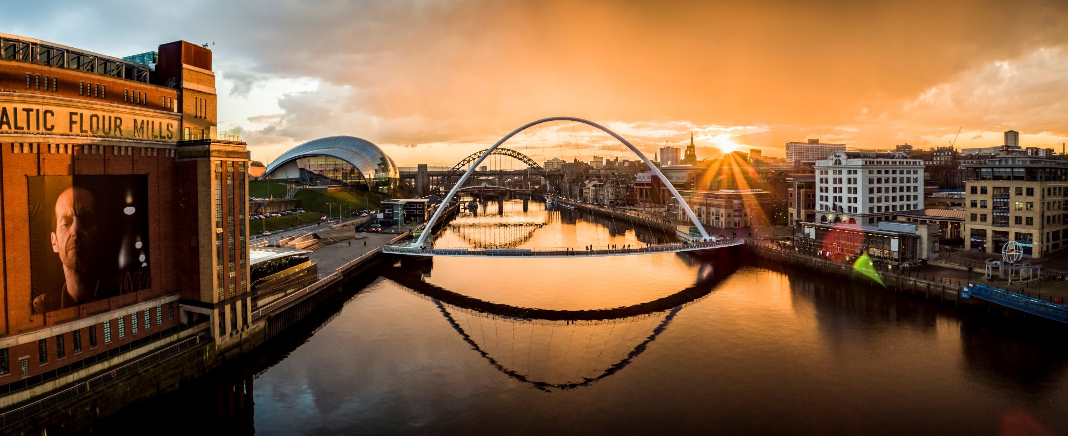
NewcastleGateshead, a cultural hub in North East England

Slide 3

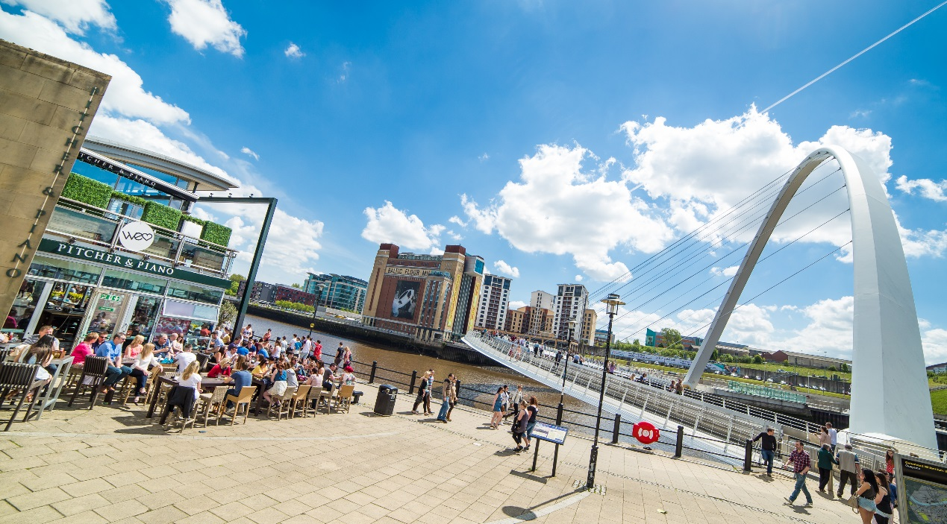
NewcastleGateshead, stitched together by seven awe-inspiring bridges

Slide 4
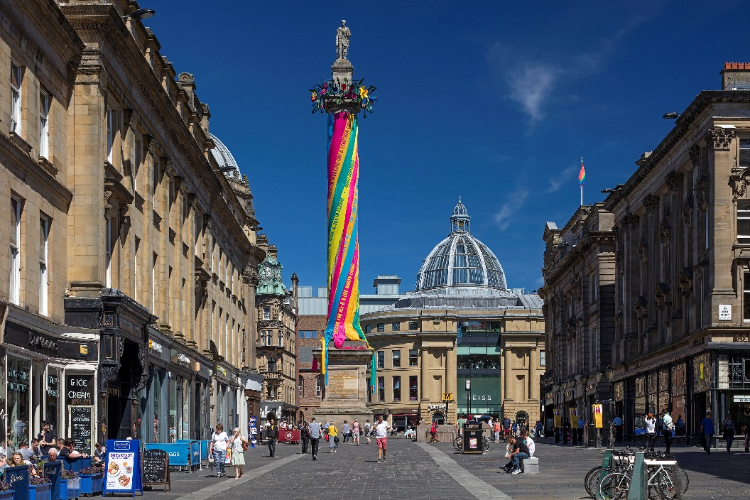
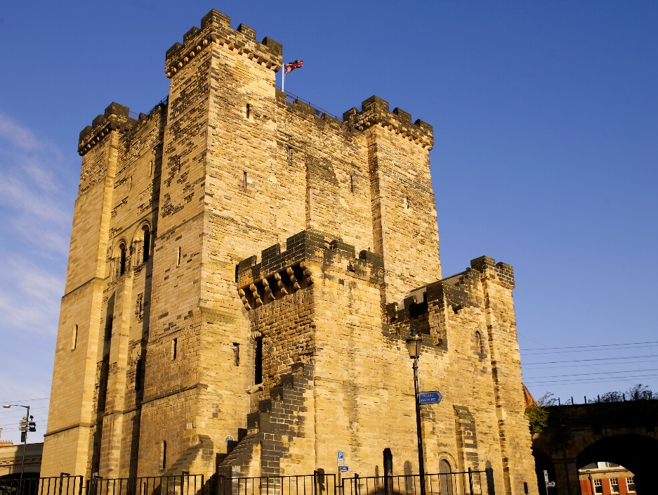
Known for its history and culture…

Slide 5
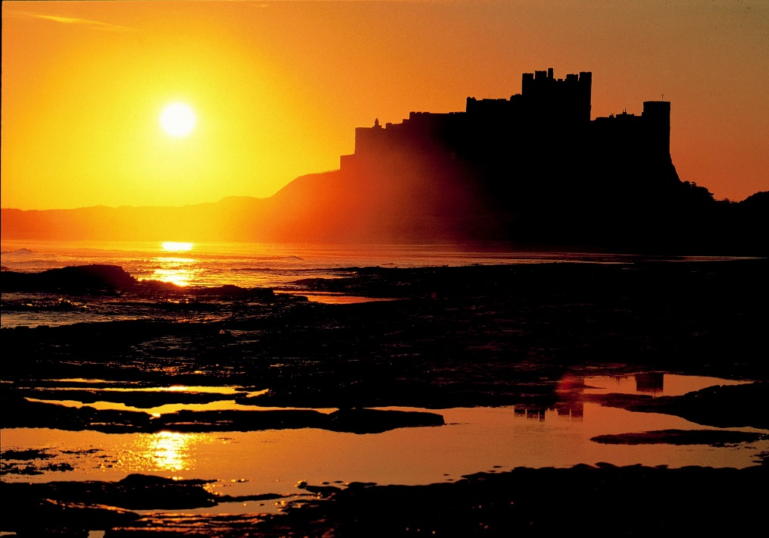
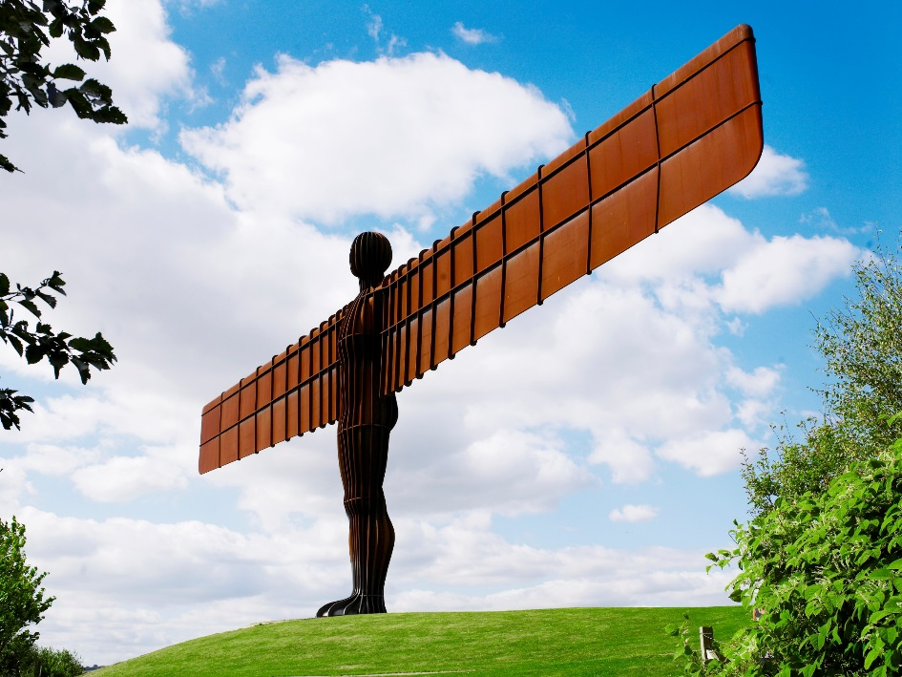
…proximity to coast and countryside…

Slide 6
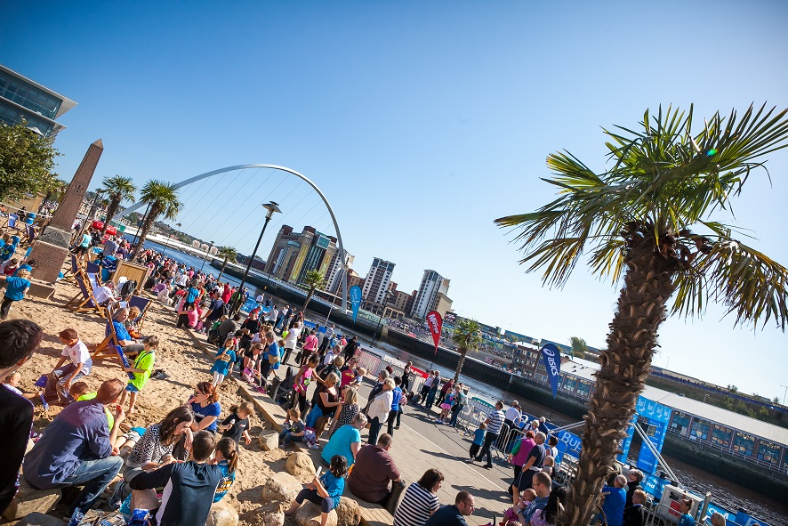
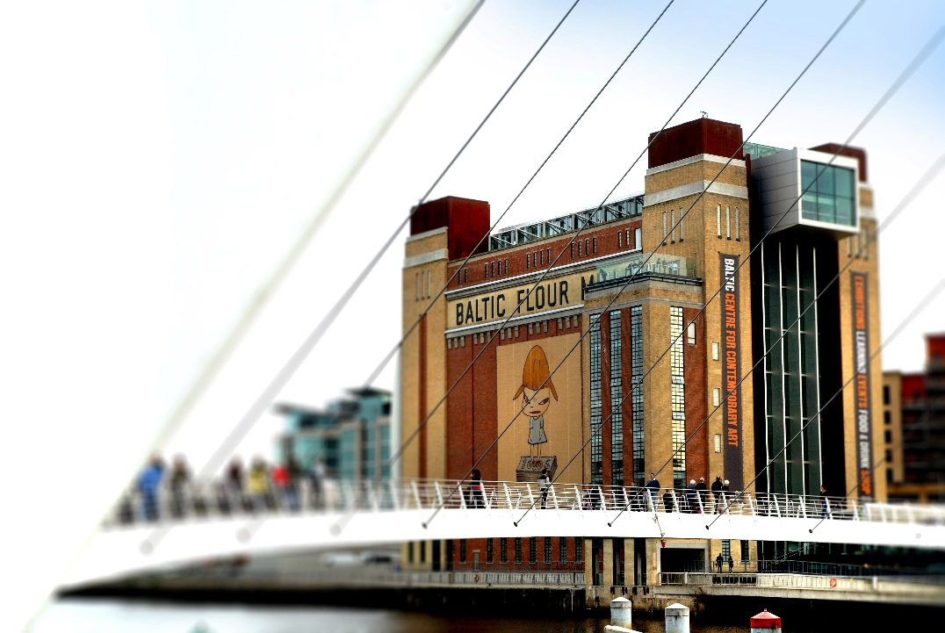
…there is much for athletes, supporters and families to enjoy!

Slide 7
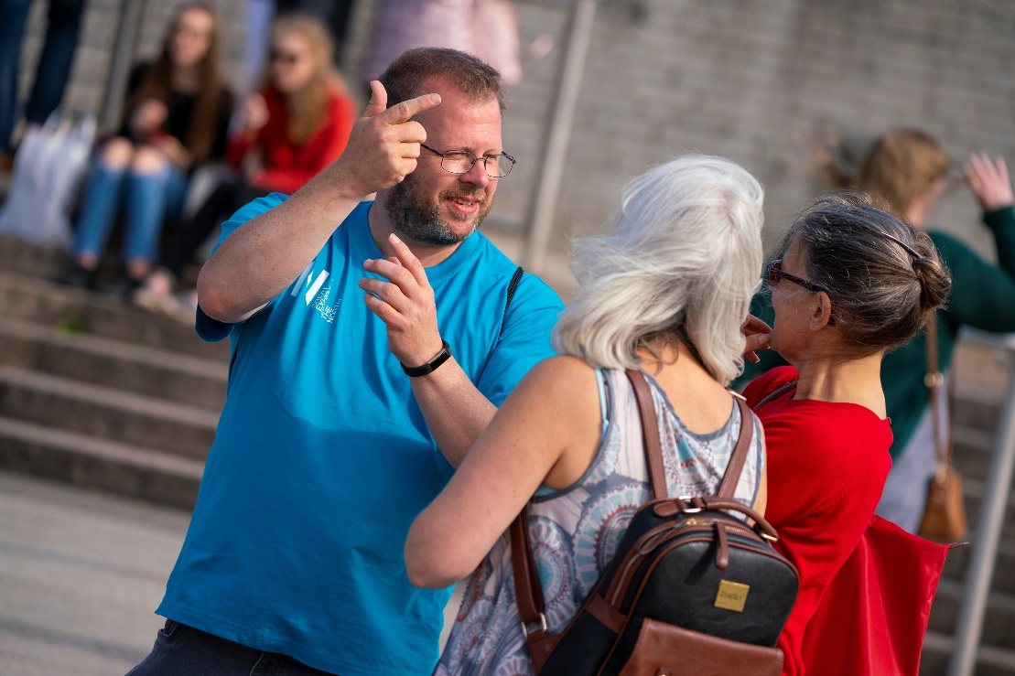
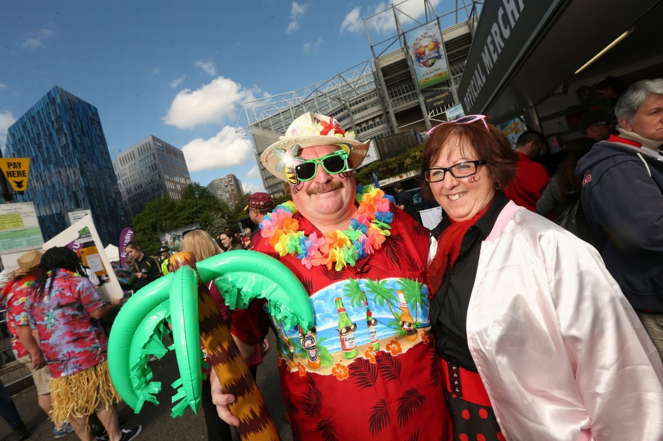
A warm welcome awaits from passionate sport fans and hundreds of enthusiastic volunteers

Slide 8
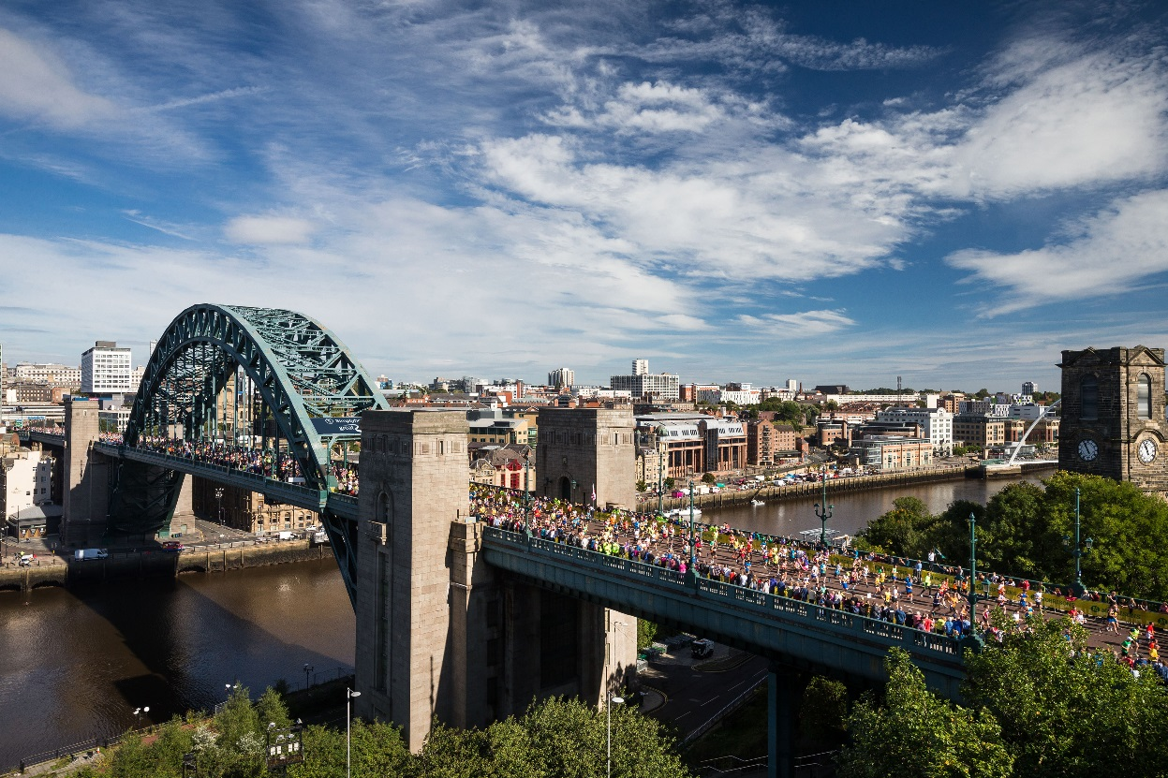
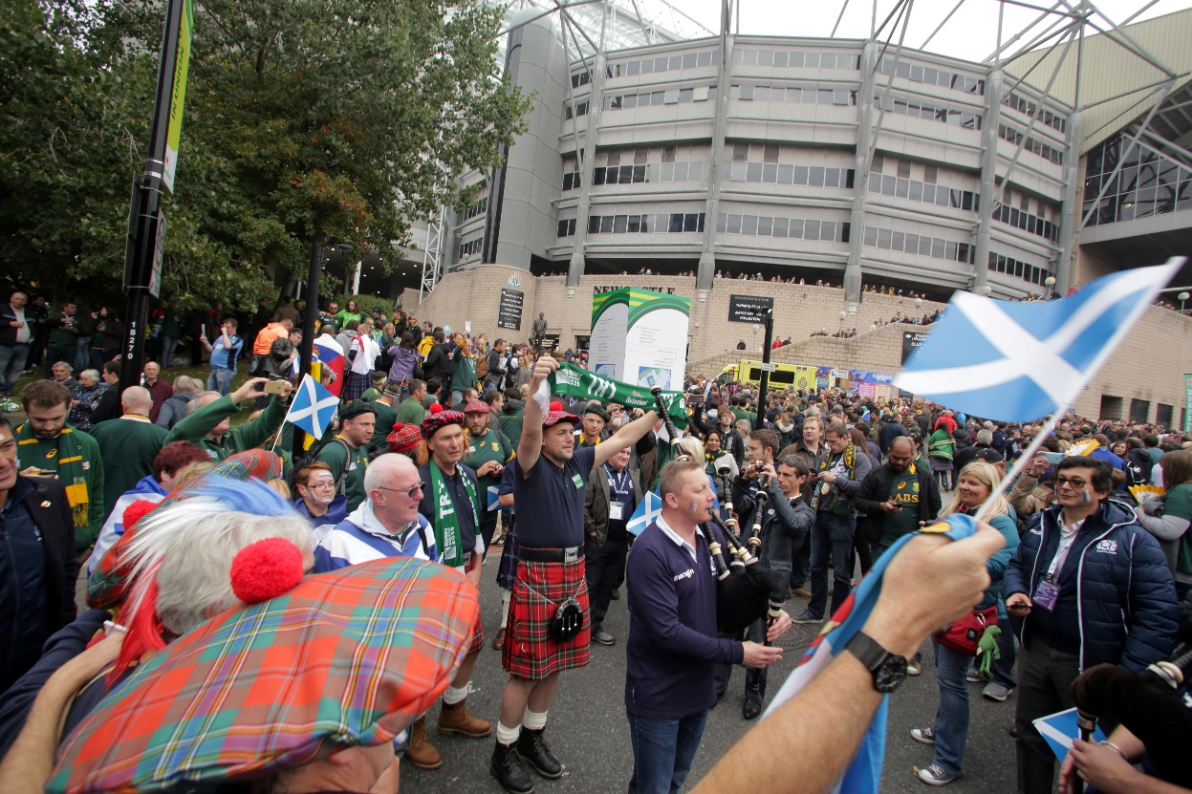
NewcastleGateshead has a track-record for delivering successful sporting events

Slide 9
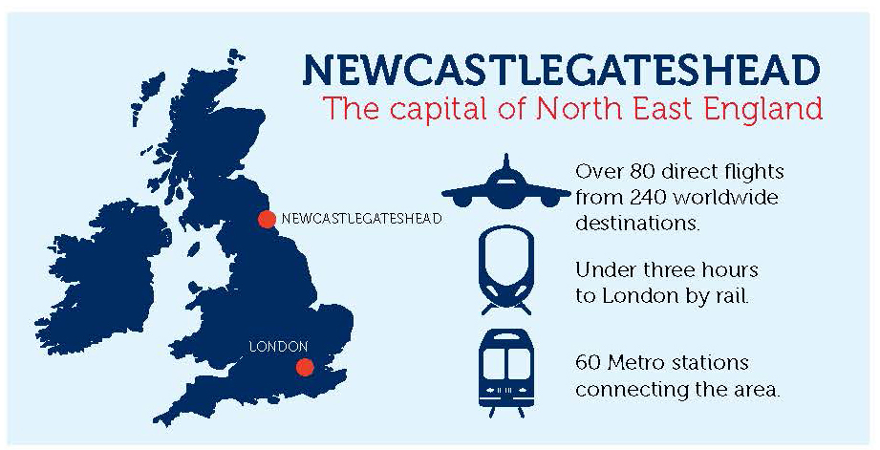
An accessible and compact destination

Slide 10
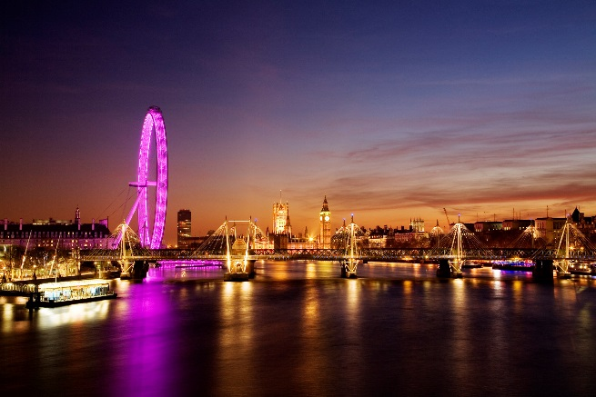
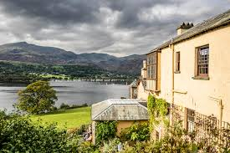
Extended Stays
For those who want to stay a little longer and explore the rest of the UK, Travel Bureau Destinations can create the perfect itinerary. Choose from the Lake District, Edinburgh, London, Cotswolds and more.

Slide 11
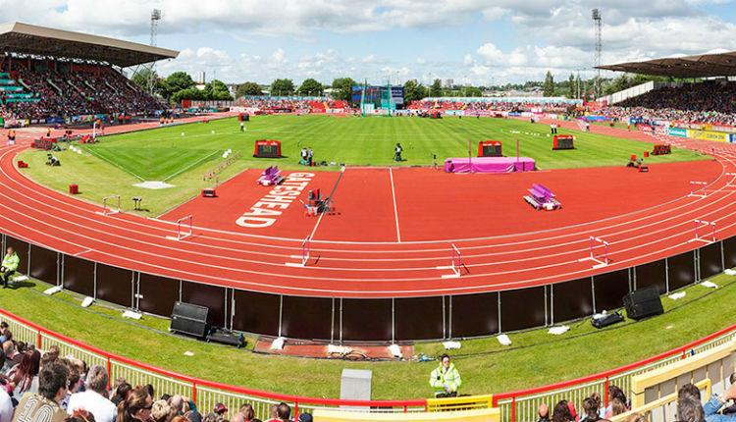
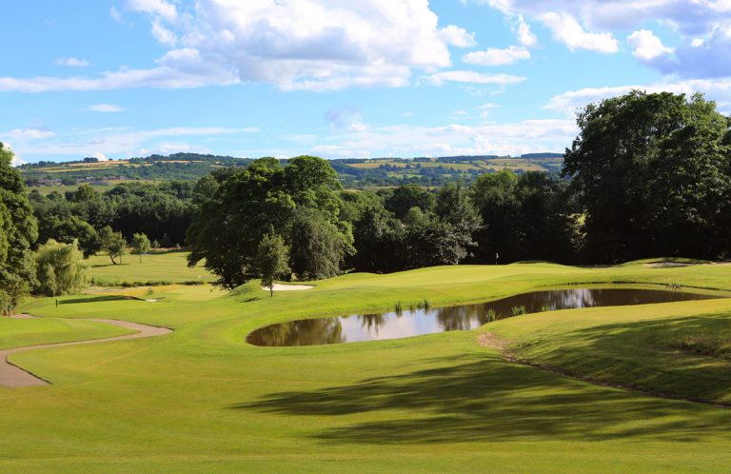
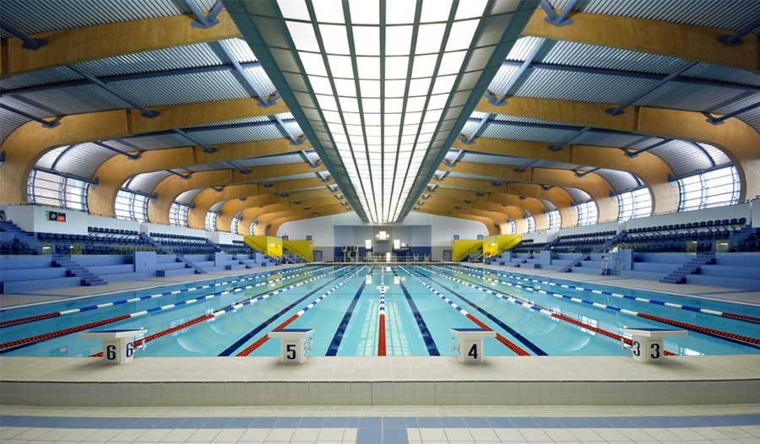
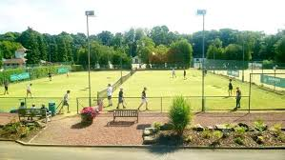
World-class sporting venues

Slide 12
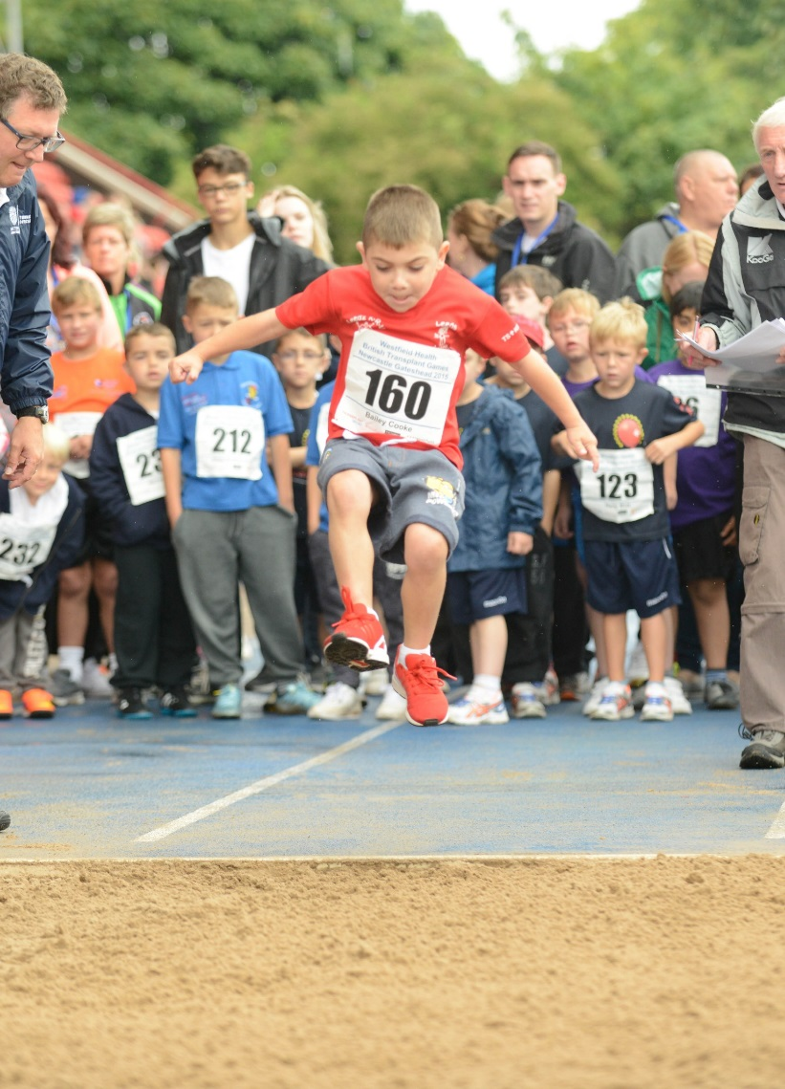
Sports Schedule
Confirmed events include:
Archery, athletics, badminton, basketball, cycling, darts, football, golf, petanque, table tennis, tennis, ten pin bowling, squash, swimming, volleyball, virtual triathlon.
*Red events open to some Junior age groups
TBC WTGF Sports Committee

Slide 13
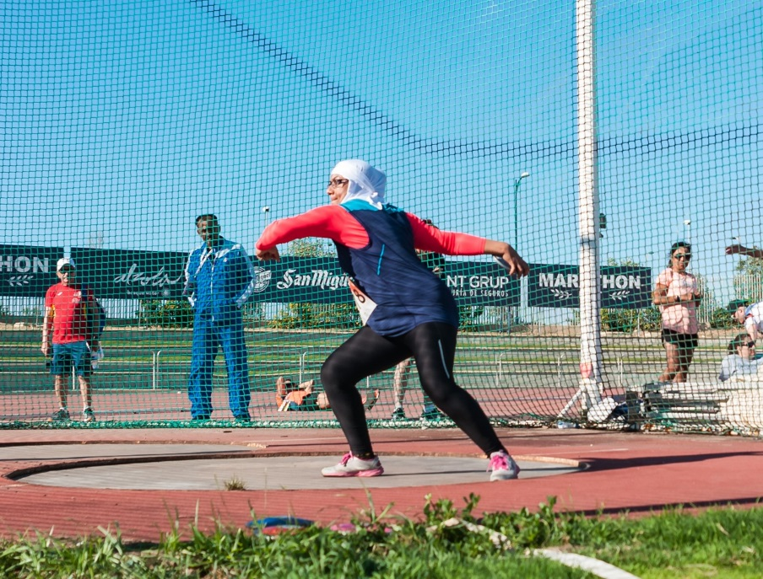
Sports Schedule – Athletics
Track and Field:
100m, 200m, 400m, 1500m, 5000m; race walk, 4 x 100m relay, 4 x 400m relay, shot put, long jump, high jump, discus, javelin.
TBC WTGF Sports Committee

Slide 14
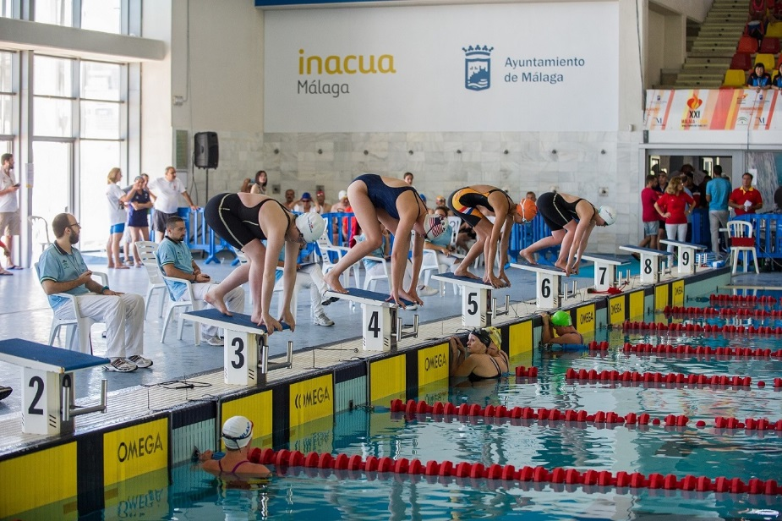
Sports Schedule – Swimming
Freestyle (50m, 100m, 200m, 400m); breaststroke (50m, 100m); backstroke (50m, 100m); butterfly (50m); 200m individual medley; 4x50m freestyle relay; 4x50m medley relay; 200m relay.
TBC WTGF Sports Committee

Slide 15
Sports Schedule – Juniors
Archery (15-17); badminton (9-11, 12-14, 15-17); cycling 5km time trial (9-11, 12-14, 15-17);
darts (9-11, 12-14, 15-17); squash (15-17);
table tennis (9-11, 12-14, 15-17);
ten pin bowling (9-11, 12-14, 15-17);
tennis (9-11, 12-14, 15-17).
TBC WTGF Sports Committee

Slide 16
Sports Schedule – Juniors
Athletics: 25m; 50m; 100m; 200m; ball throw;
high jump; long jump; shot putt.
Swimming: Freestyle (25m, 50m, 100m, 200m); breaststroke (25m, 50m, 100m); backstroke (25m, 50m, 100m); butterfly (25m, 50m).
TBC WTGF Sports Committee

Slide 17
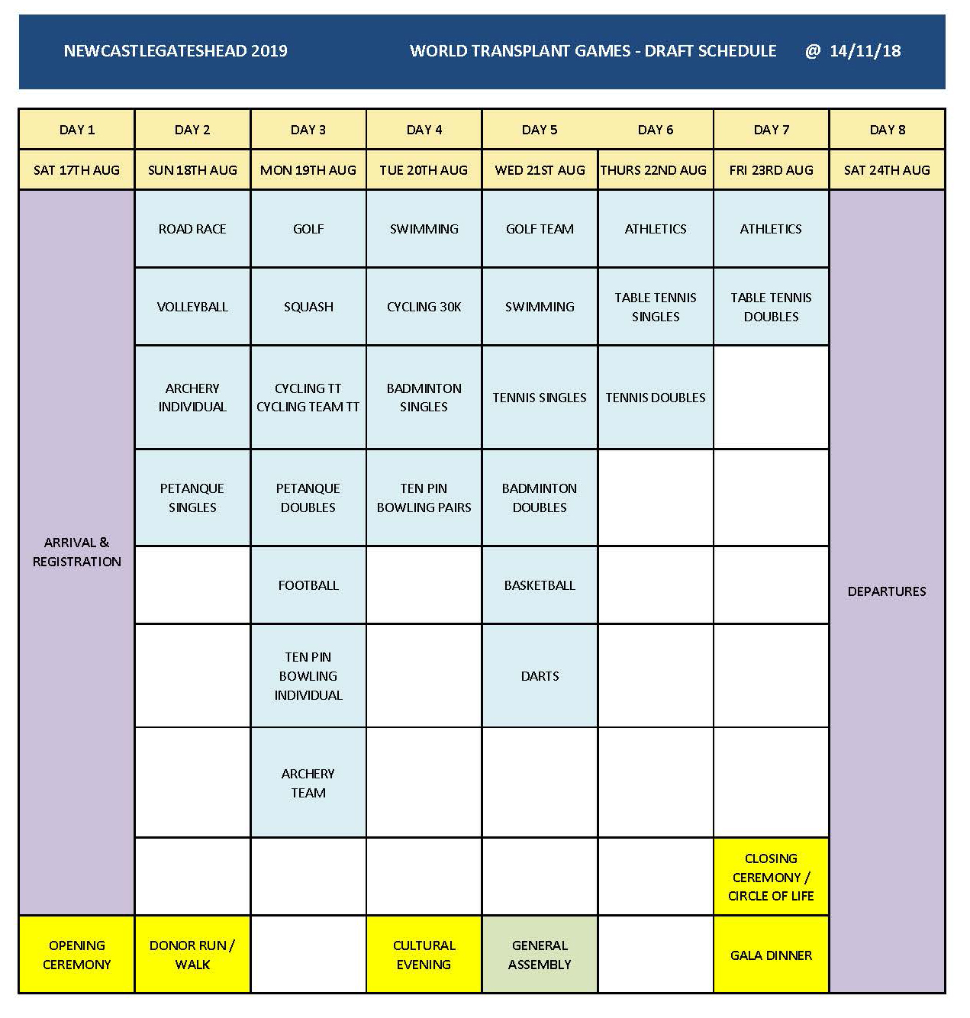
TBC WTGF Sports Committee

Slide 18
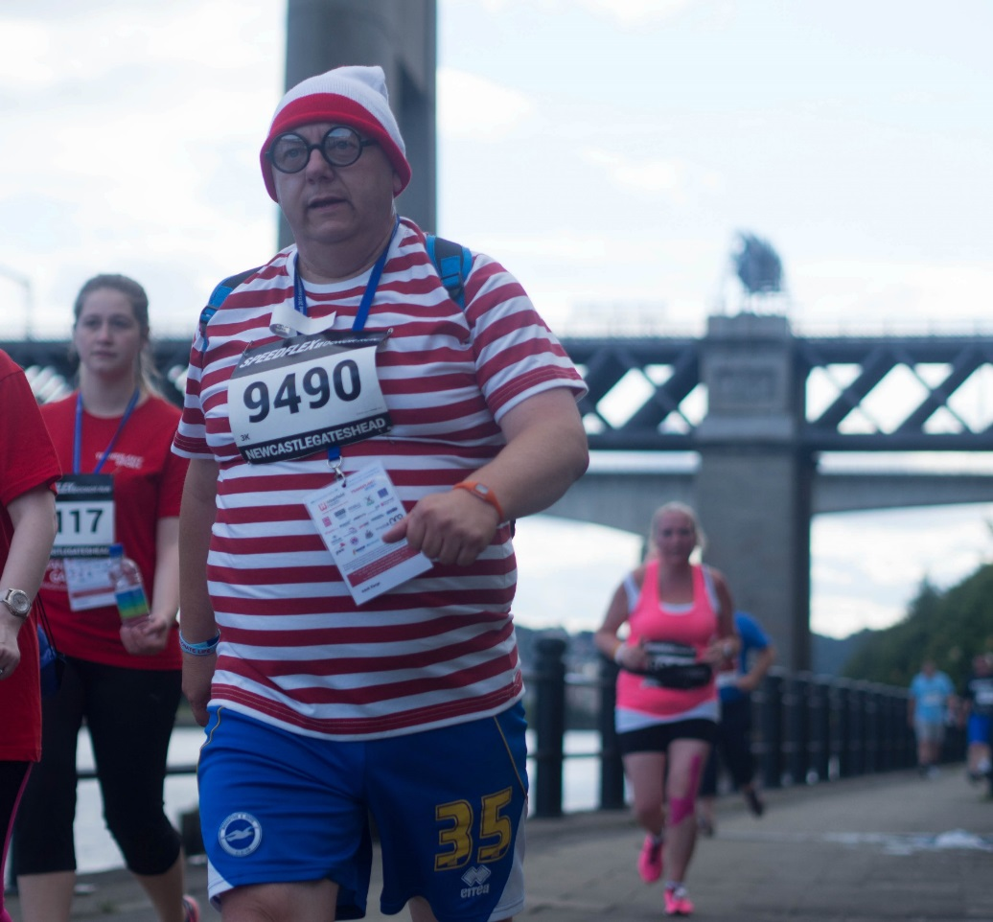
Donor families and living donors events include:
5km road race, 50m freestyle swim, 100m athletics, sprint, ball throw and long jump.
TBC WTGF Sports Committee

Slide 19
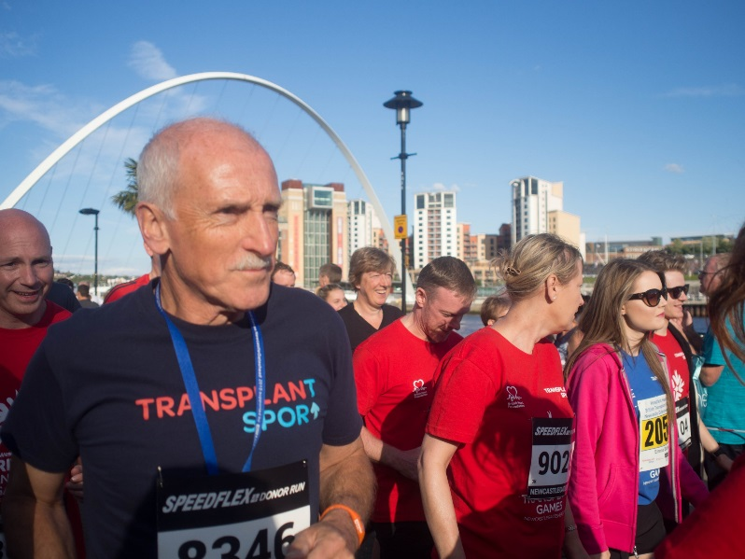
WTG2019 Registration timeline
3 December 2018 to 18 January 2019: Early Bird Registration
15 February 2019: deadline for full Early Bird payment
19 January to 1 May: Full Registration
15 May: Deadline for full payment

Slide 20

WTG2019 Registration Fees
A range of accommodation tiers are offered to make the Games more accessible and affordable for participants and supporters.
To keep teams together we strongly recommend early registration.

Slide 21
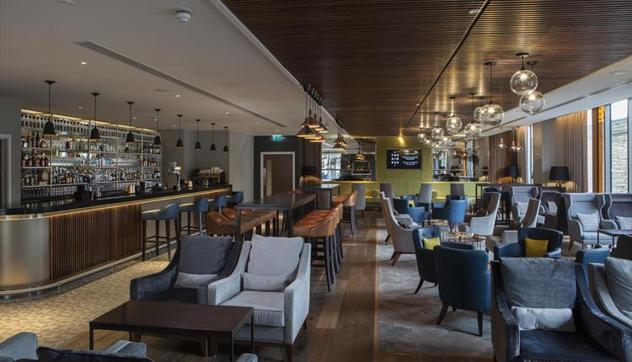

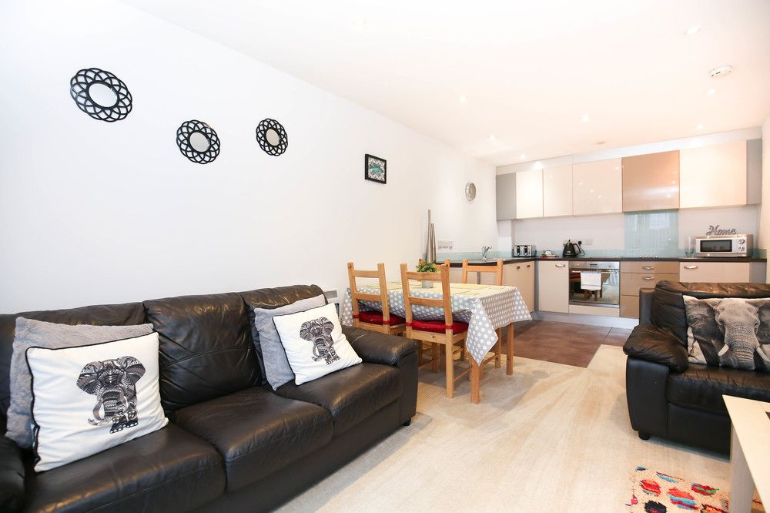
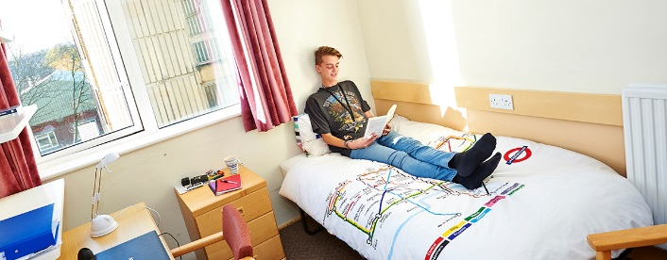
Over 7500 bedrooms from budget to four-star luxury

Slide 22
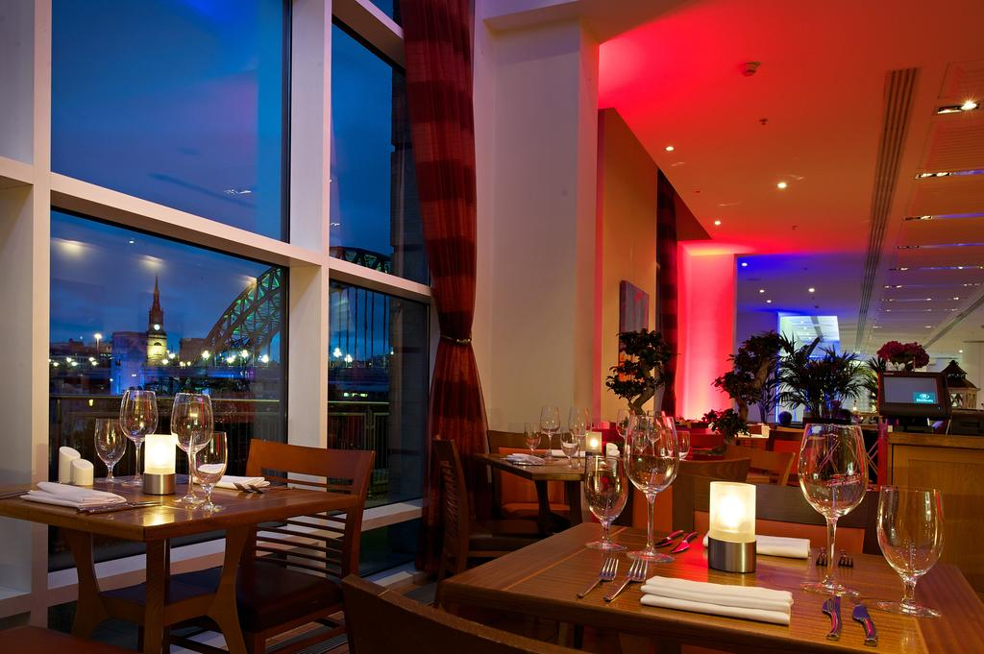
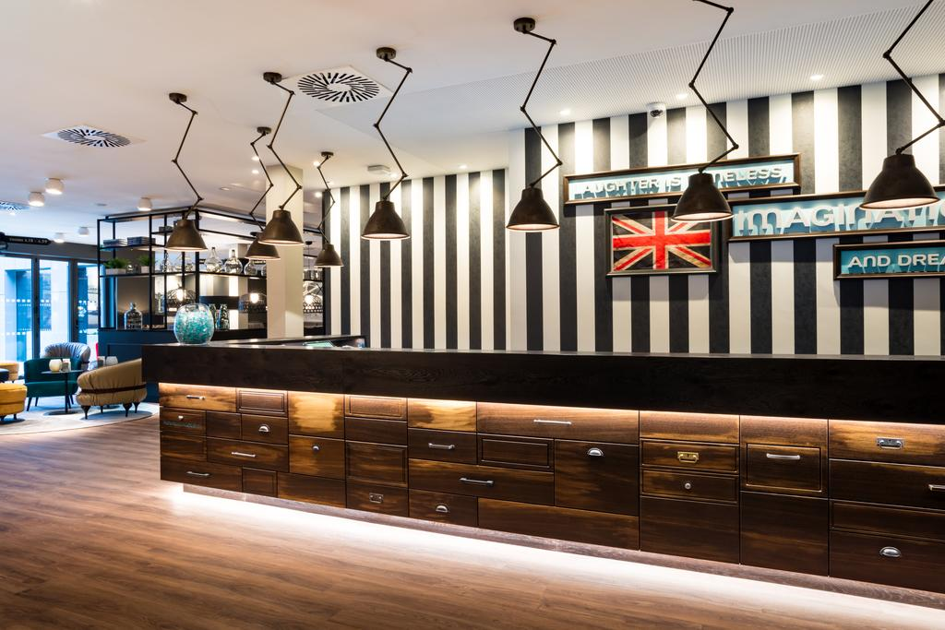
Standard and 4 star hotels and University accommodation
Package includes:
Full board for 7 nights, accreditation to participate in or be a spectator at the Games, attendance to all official events and ceremonies, transport to venues and unlimited travel on the local metro public transport system.

Slide 23
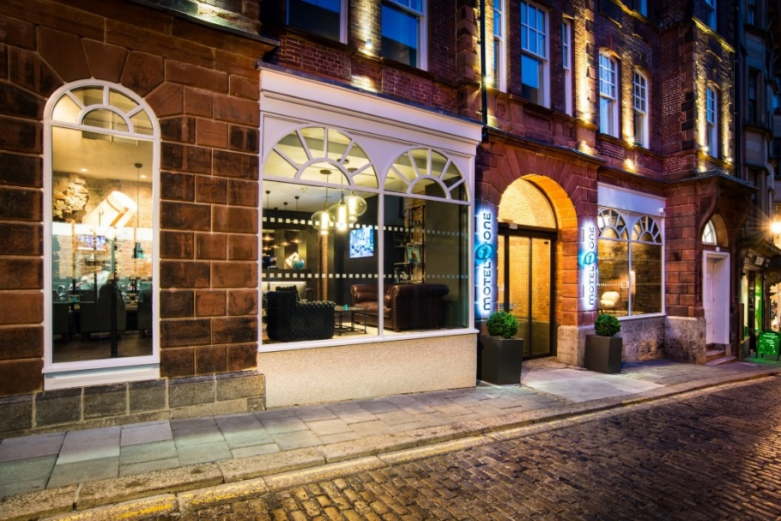
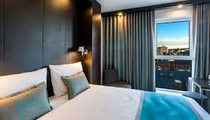
Standard accommodation:
Full service hotels inclusive of breakfast and evening meals.
From £793 per person / £423 per junior sharing. (Discount of £150 per child sharing with 2 adults – up to 2 children).

Slide 24
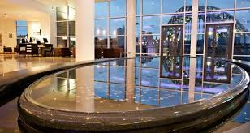
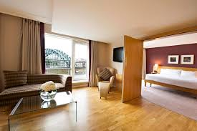
4 star – upgrade your experience!
Superior hotel accommodation with larger bedrooms and advanced amenities and standards. State of the art gym facilities and swimming pools.
From £923 per person / £523 per junior sharing (discount of £150 per child sharing with 2 adults – up to 2 children).

Slide 25
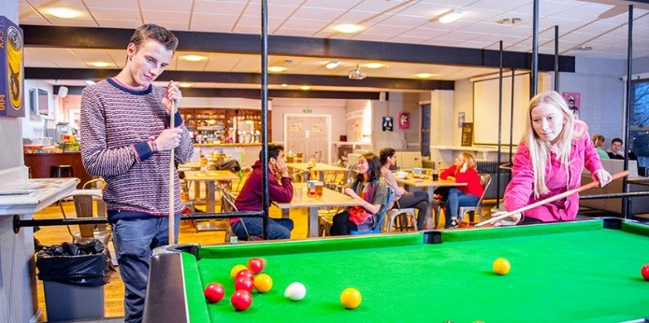

University accommodation -
the Games Village experience!
Private en-suite facilities, breakfast is continental style grab and go, buffet evening meals (10 mins walk) and large communal spaces for teams to gather. 15 years and above only. From £623 per person, single occupancy.

Slide 26
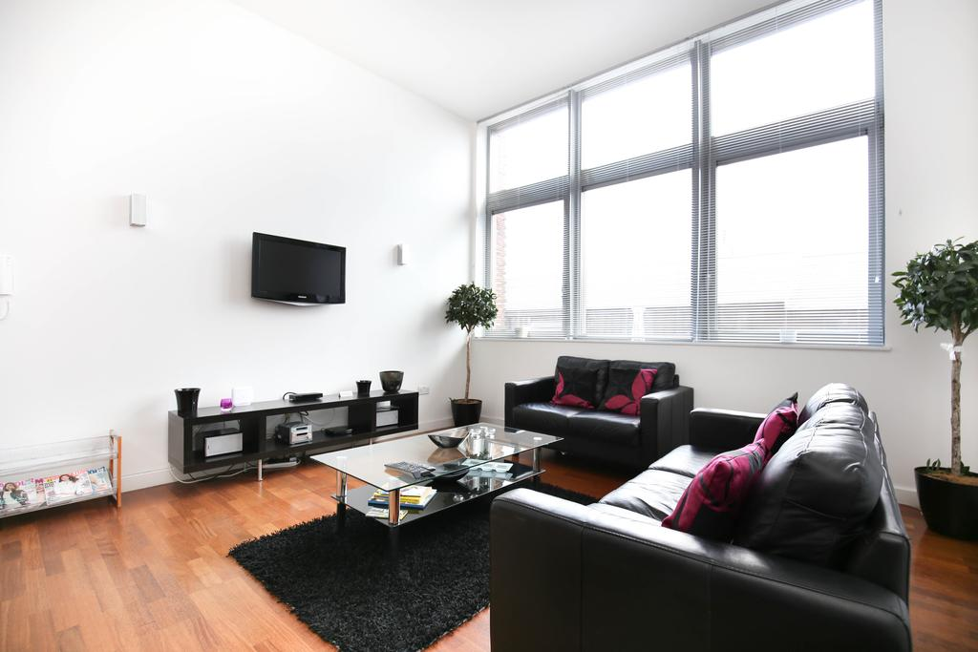

Family self-catering option includes:
7 nights accommodation in a centrally located apartment, packed lunches at Games venues, accreditation to participate in or be a spectator at the Games, attendance to all official events and ceremonies, transport to venues and unlimited travel on the local metro transport system.

Slide 27
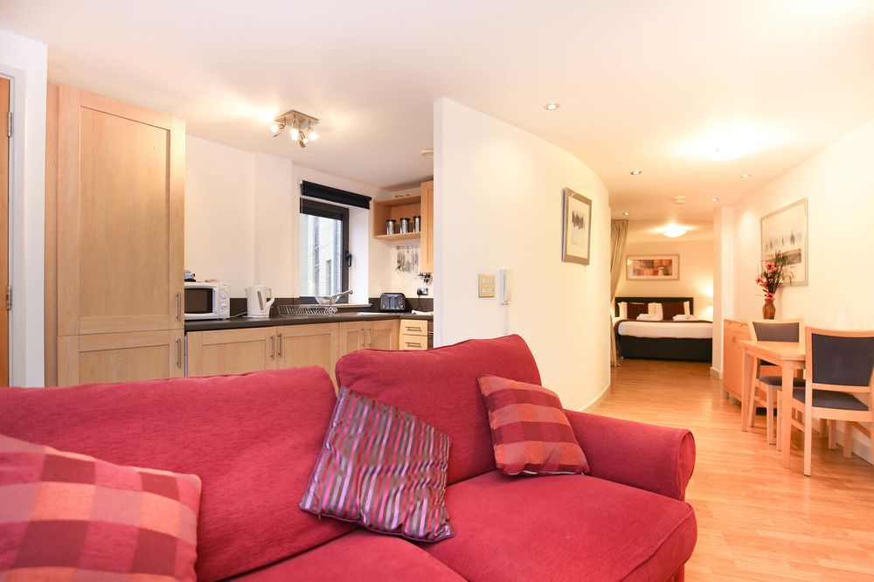
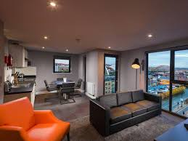
Family self-catering option
For families with juniors aged 12 or below, 1, 2 and 3 bedroom apartments. (Min 2 adults, 1 child; max 7 persons).
From £573 per person / £523 per junior.

Slide 28
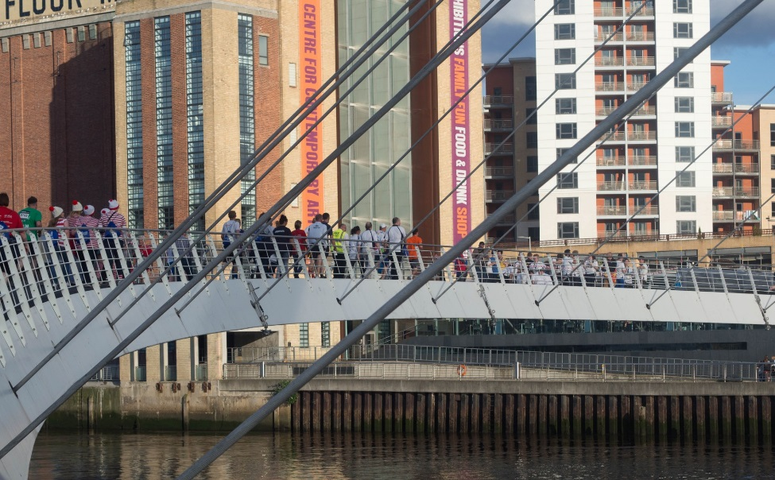
Non accommodation fee
Accreditation only includes packed lunches at Games venues, accreditation to participate in or be a spectator at the Games, attendance to all official events and ceremonies (include food), designated transport to venues from agreed pick up locations, unlimited travel on Metro transport system.
From £523 per person / £323 per junior.
No transfers for arrival/departure days for accreditation only.

Slide 29
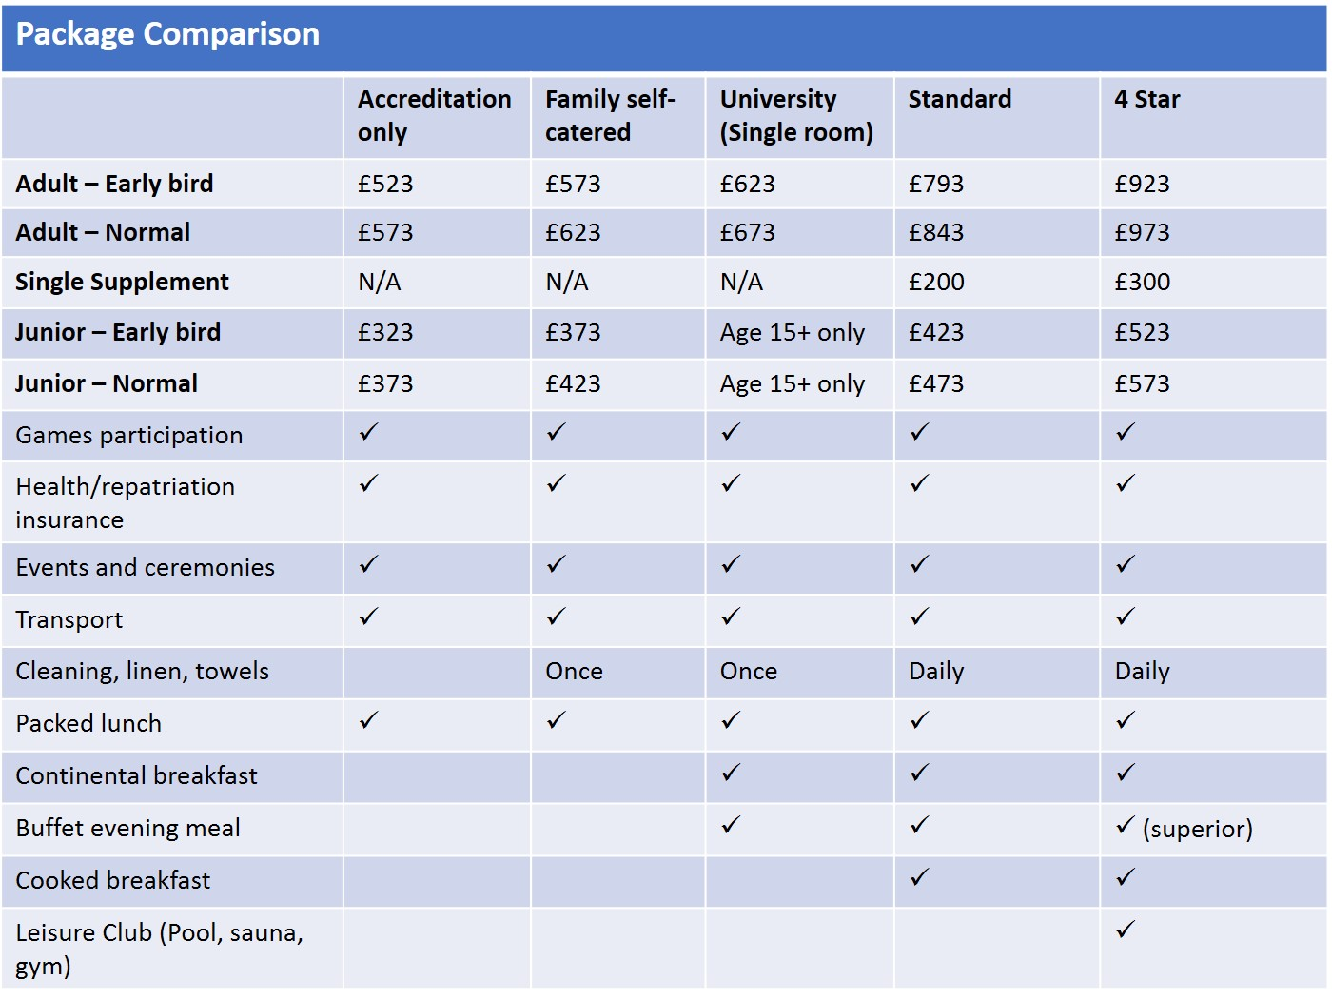

Slide 30

Medical Information
Medical Certificates – results from mid February onwards.
Deadline for returning – mid June.
Drop in Clinics - Medical/Physio:
Hilton Hotel Gateshead and Newcastle Civic Centre

Slide 31


Slide 32

17 – 24 August 2019
www.worldtransplantgames.org

